Slide 1
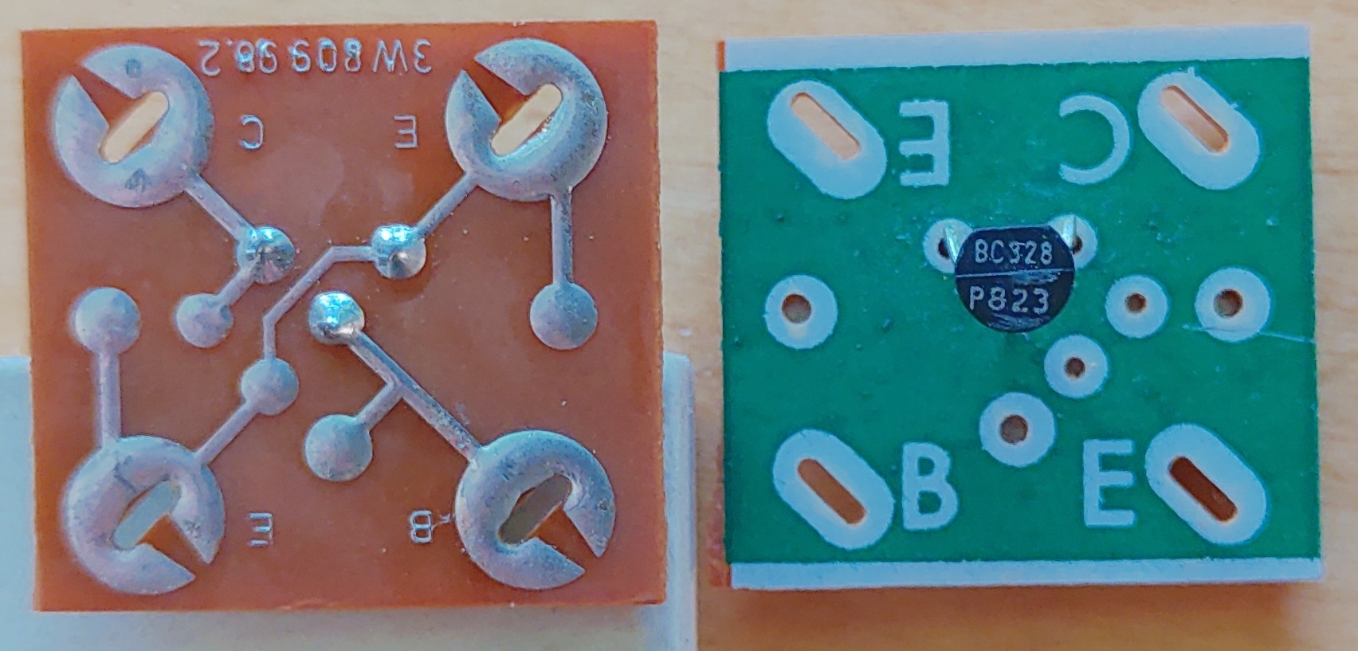
E
C
Important:
Print at:
A4 format
Print to size (i.e. no scaling/fitting)
Highest print quality
Lowest speed
BC238
B
E
E
C
E
C
E
C
E
C
E
C
E
C
E
C
E
C
B
E
B
E
B
E
B
E
B
E
B
E
B
E
B
E
E
C
E
C
E
C
E
C
E
C
E
C
E
C
E
C
B
E
B
E
B
E
B
E
B
E
B
E
B
E
B
E
E
C
E
C
E
C
E
C
E
C
E
C
E
C
E
C
B
E
B
E
B
E
B
E
B
E
B
E
B
E
B
E
E
C
E
C
E
C
E
C
B
E
B
E
B
E
B
E

Slide 2
Specialty designs (1)
LEDs
Low-dropout Voltage Regulator (LDO)
K
A
K
A
K
A
K
A
0
In
0
In
0
In
0
In
K
K
K
K
LDO 5V
0
LDO 5V
0
LDO 3V
0
LDO 3V
0
Out
Out
Out
Out
K
A
K
A
K
A
K
A
ZN414 or MK484 Radio chip (AM receiver/detector) and double varactor (BB212)
0
0
C
C
K
K
K
K
RFin
RFin
A1
A1
MK484 AM recv
MK484 AM recv
BB212 Varicap
BB212 Varicap
Switch (C = middle position)
RGB LEDs (common Anode) – cut the E-E track!
0
0
C
C
C
C
Out
Out
A2
A2
Sw1
Sw1
G
R
G
R
JFET (BF244/BF245) and MOSFET)
Sw2
C
Sw2
S
D
S
D
S
D
S
D
C
A
B
A
B
MOSFET
MOSFET
FET
FET
Digital interfacing, sensors and actuators
G
S
G
S
G
S
G
S
0
0
0
0
Vdd
Vdd
Vcc
Vcc
Interface boards to 2- 3- (or 4-)legged devices
DS18B20 Temp
DS18B20 Temp
IRrecv 38KHz
IRrecv 38KHz
0
0
0
0
DQ
DQ
Out
Out
0
0
1
2
1
2
1-W
1-W
DS2890 Rvar
DS2890 Rvar
Buzzer
Buzzer
0
0
1
1
RH
RH

Slide 3
Specialty designs (1)
+
A
+
A
AB
AB
E
-
E
-

